Slide 1
TourneyHub
Website Tempat Hosting Tournament
Progress #2 – Initial Sketch

Slide 2
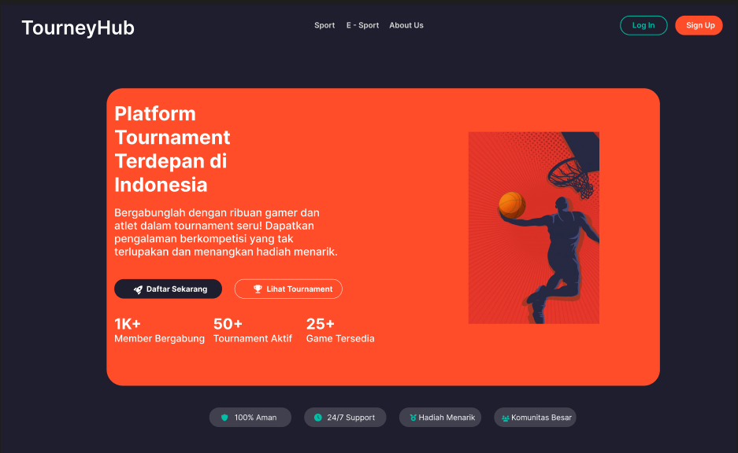
Design Figma Welcome Page

Slide 3
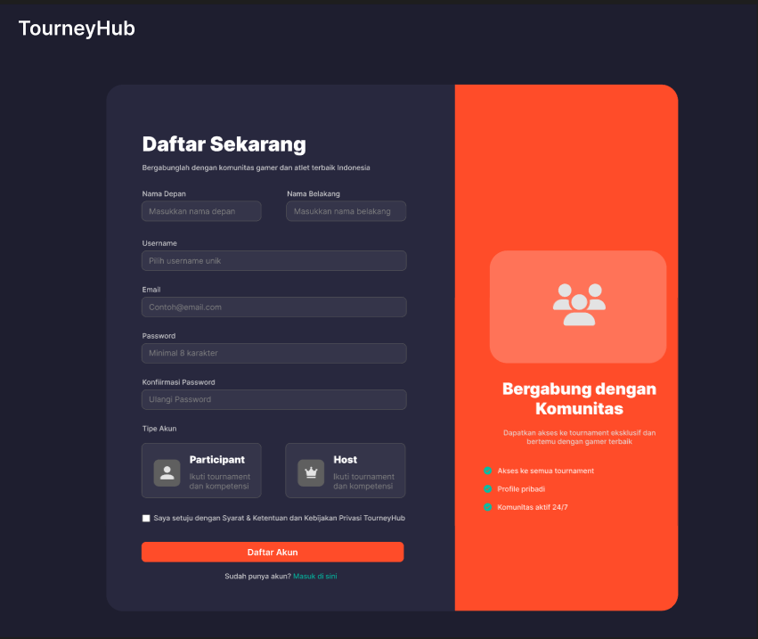
Design Figma Sign Up Page

Slide 4
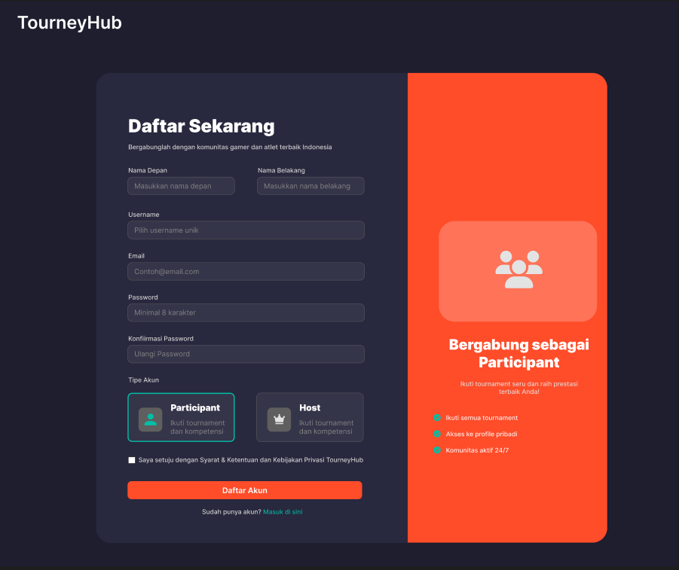
Design Figma Sign Up Page – Participant

Slide 5

Design Figma Sign Up Page – Host

Slide 6
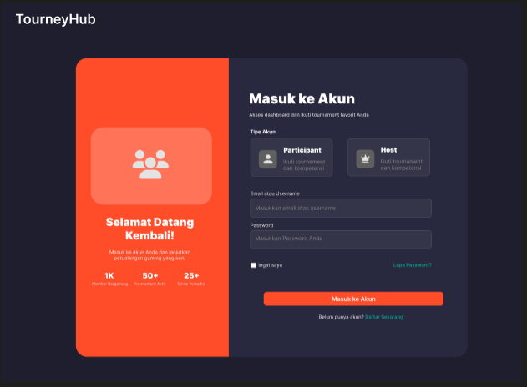
Design Figma Log In Page

Slide 7
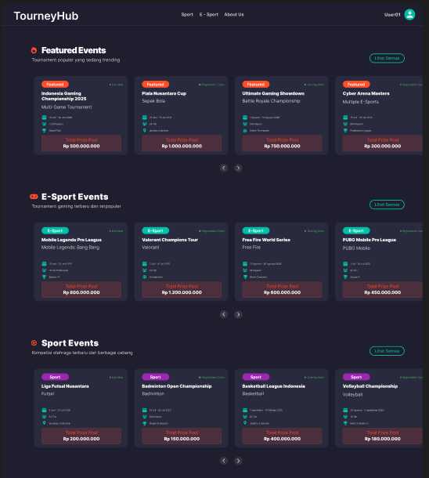
Design Figma Home Page

Slide 8
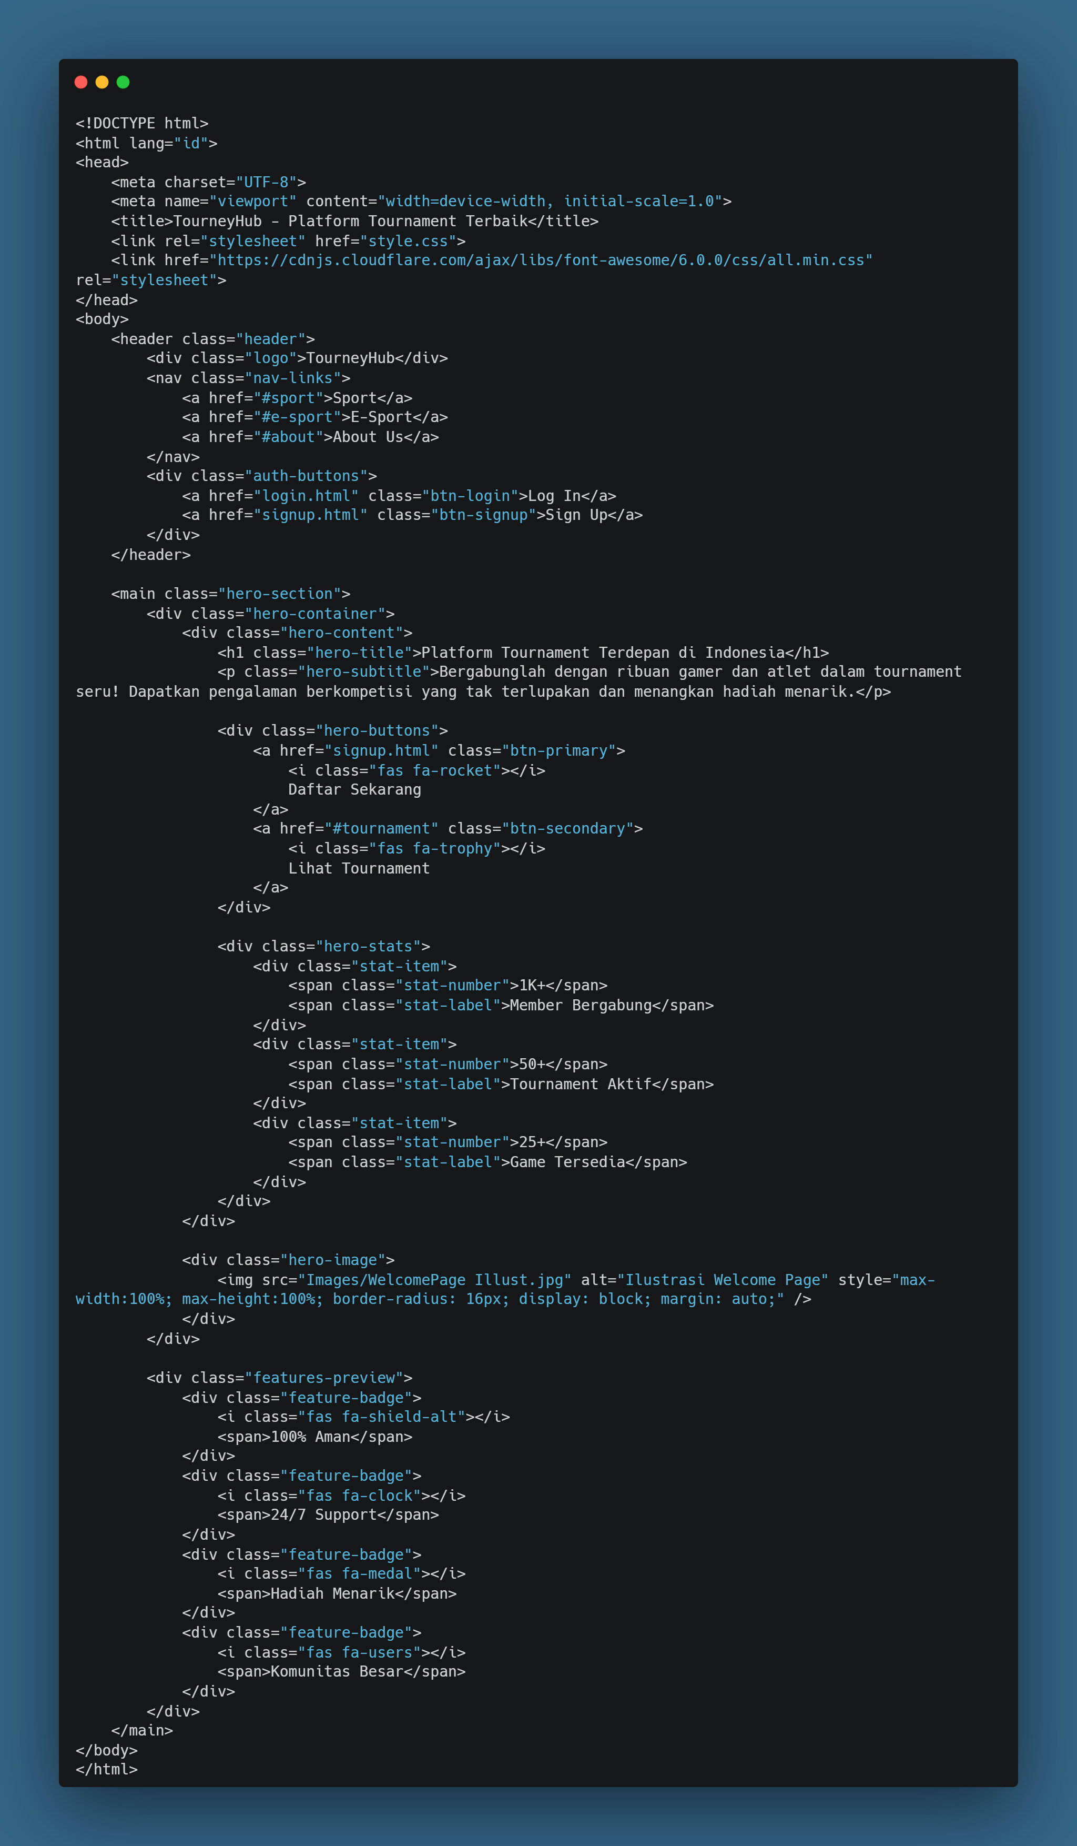
Coding Welcome Page

Slide 9
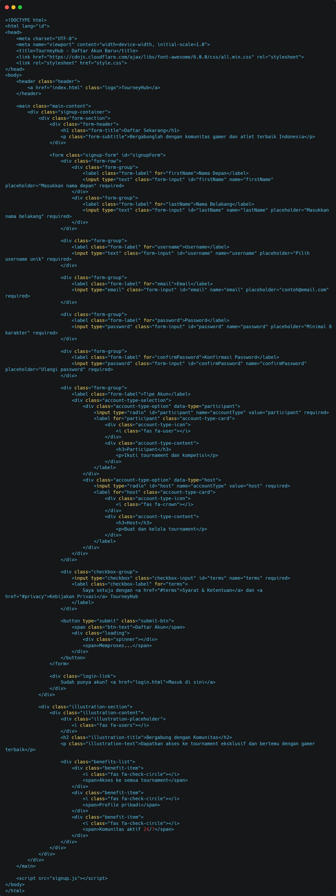
Coding Sign Up Page

Slide 10
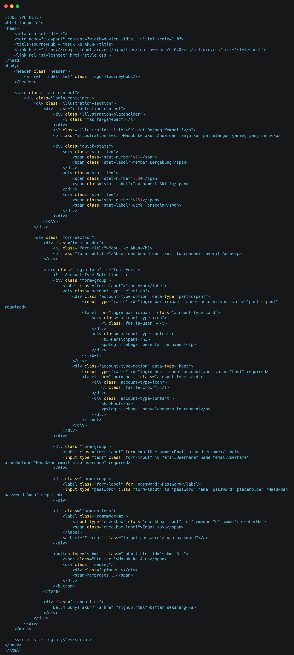
Coding Log In Page

